Slide 1
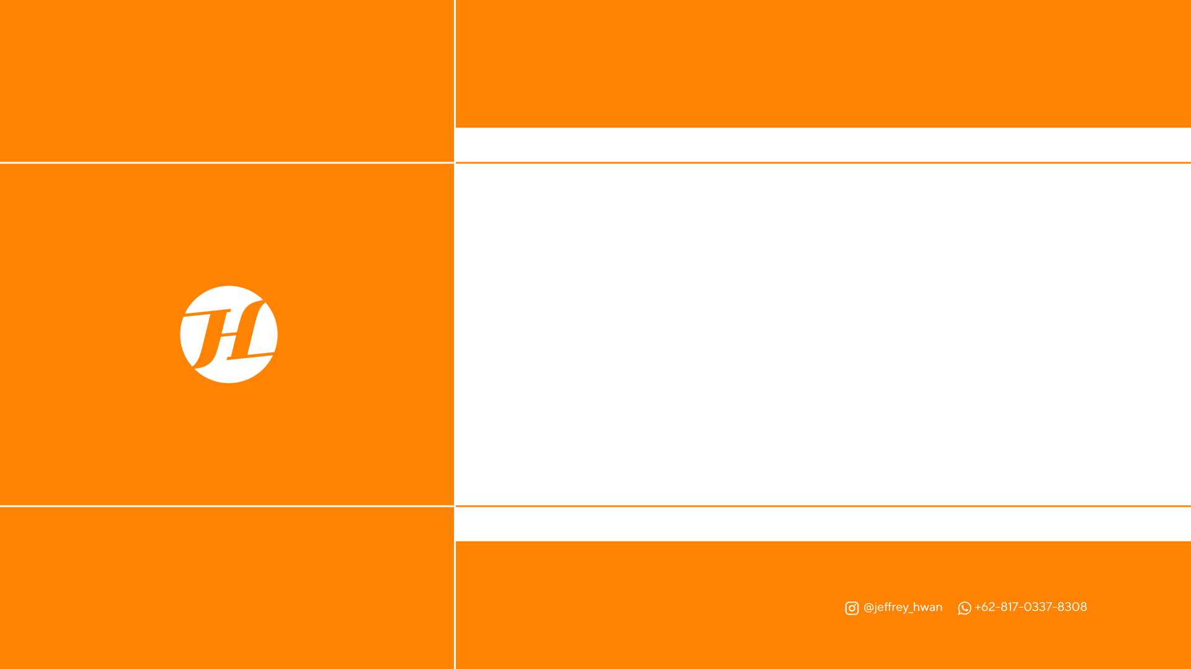
INSTAGRAM CONTENT DESIGN
PRICELIST 2022

Slide 2
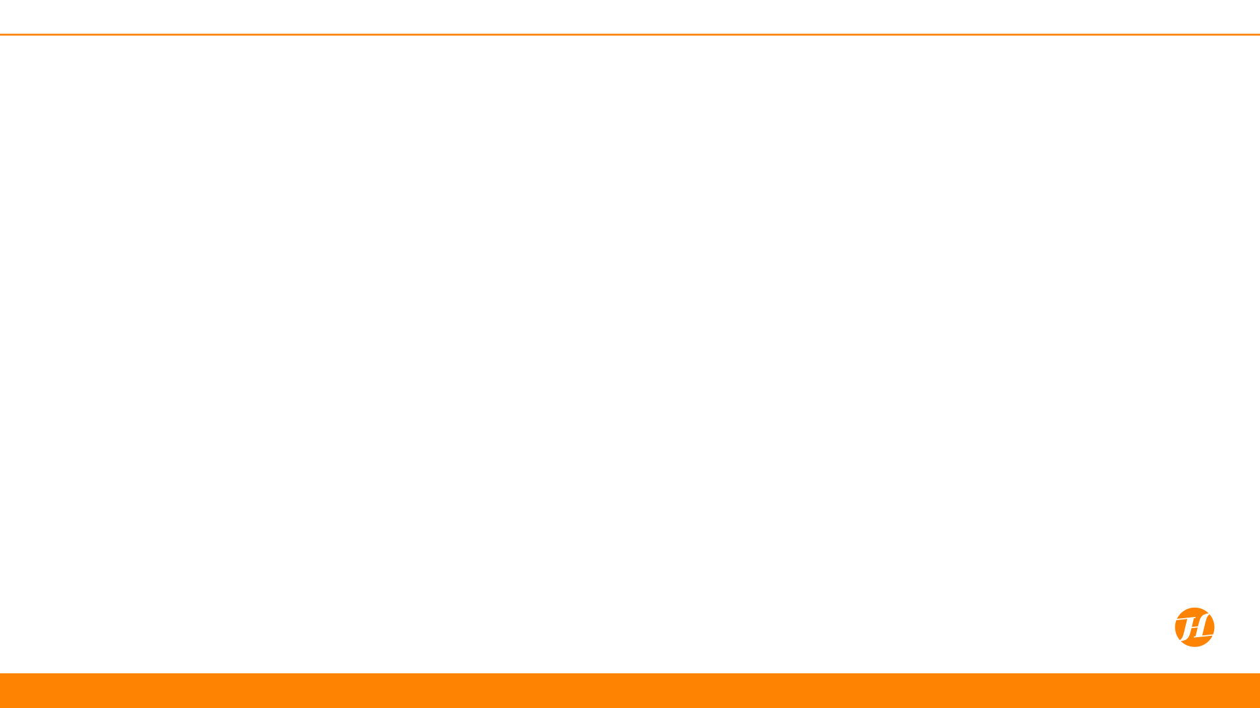
OUR PORTFOLIO

Slide 3
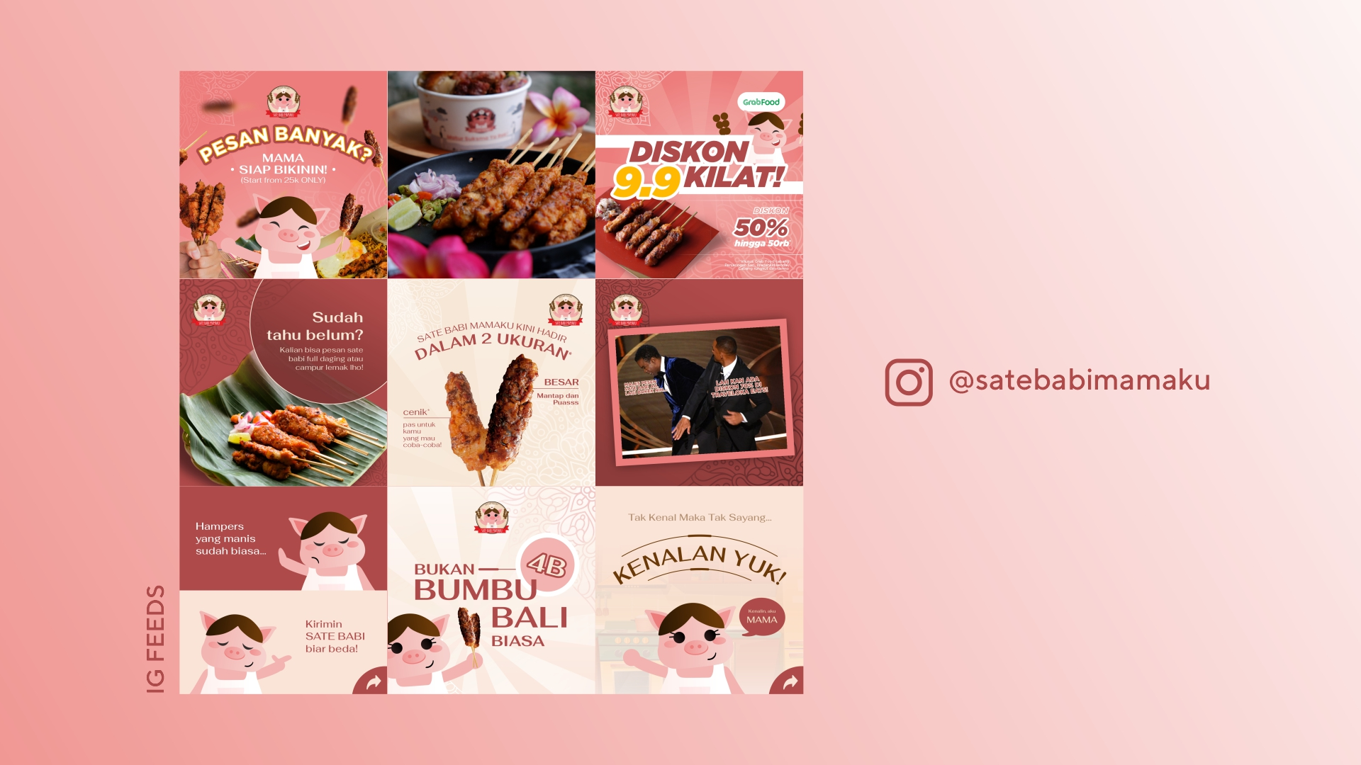

Slide 4
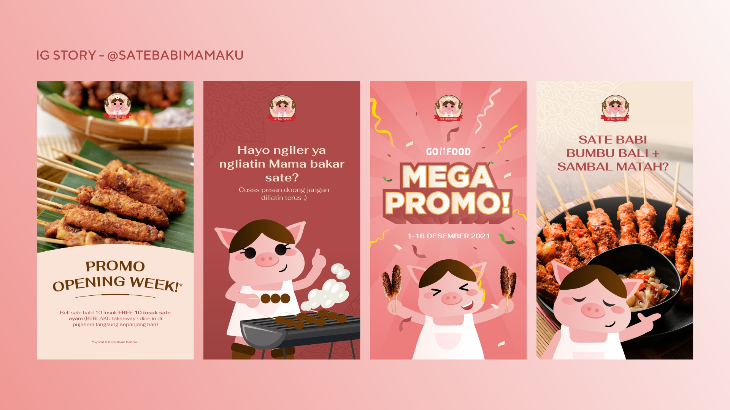
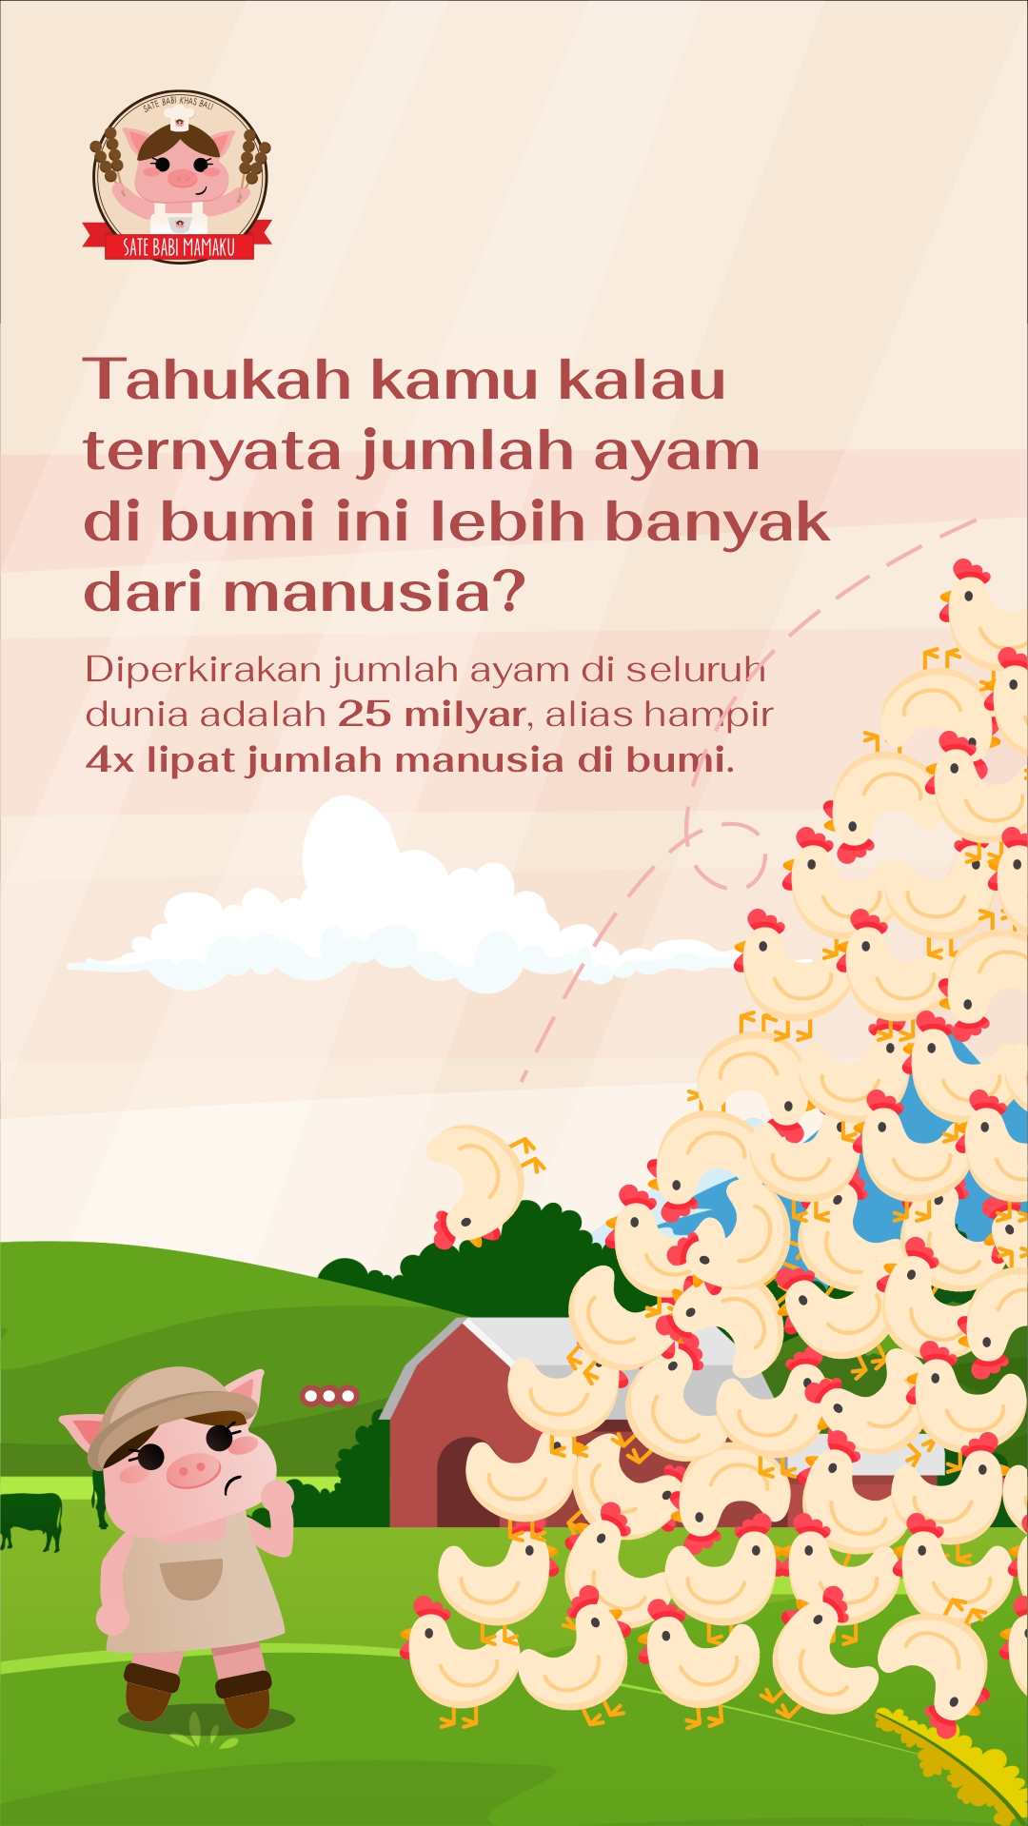

Slide 5
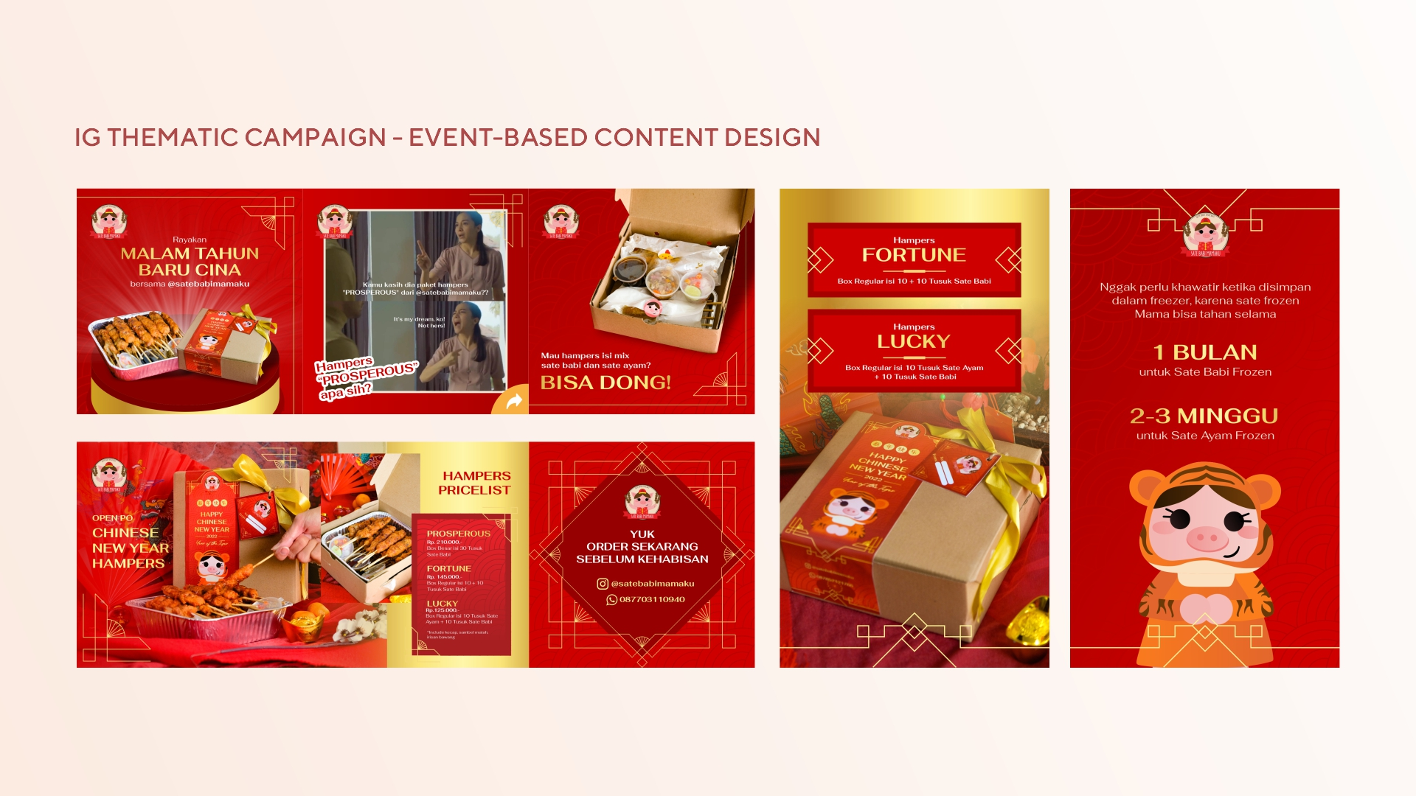

Slide 6
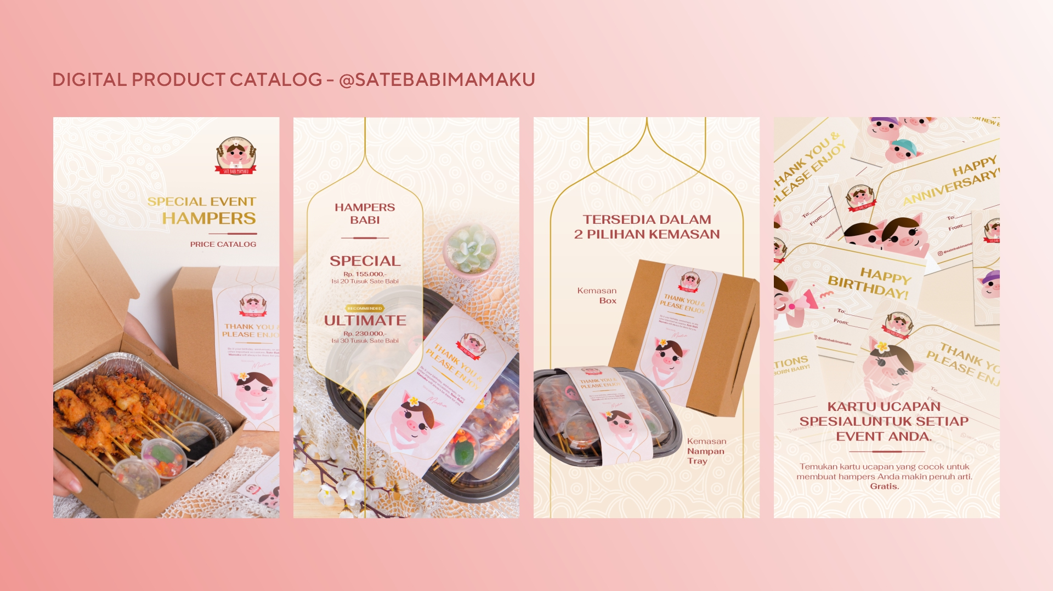

Slide 7

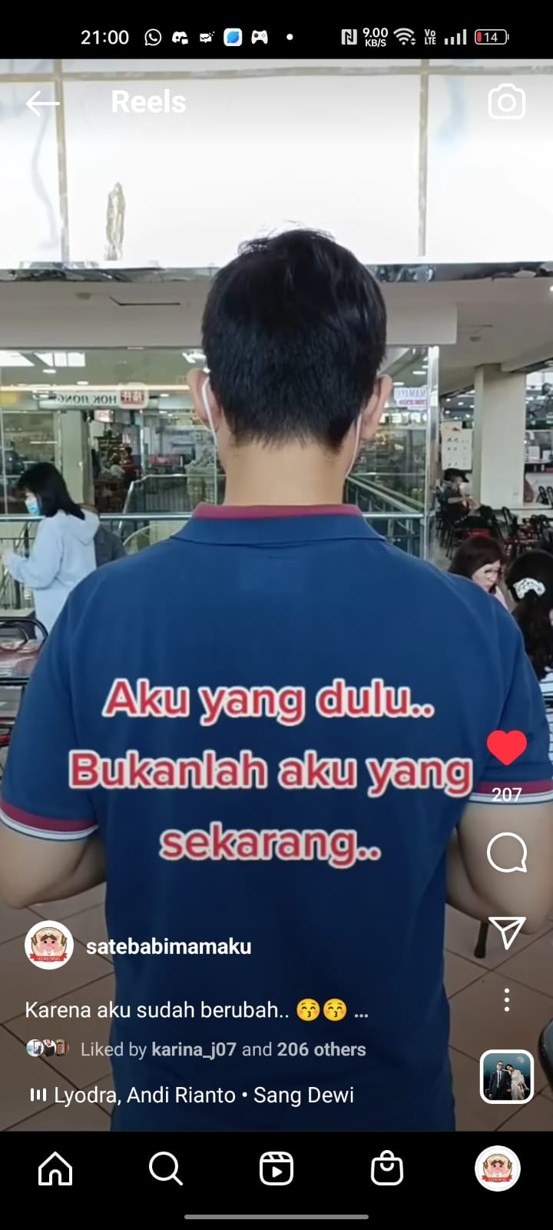
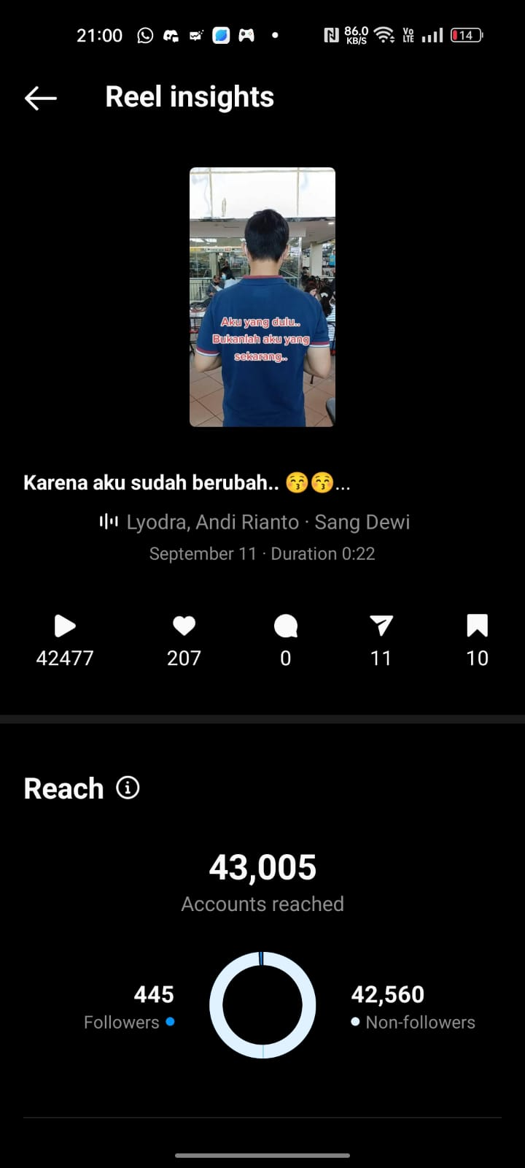
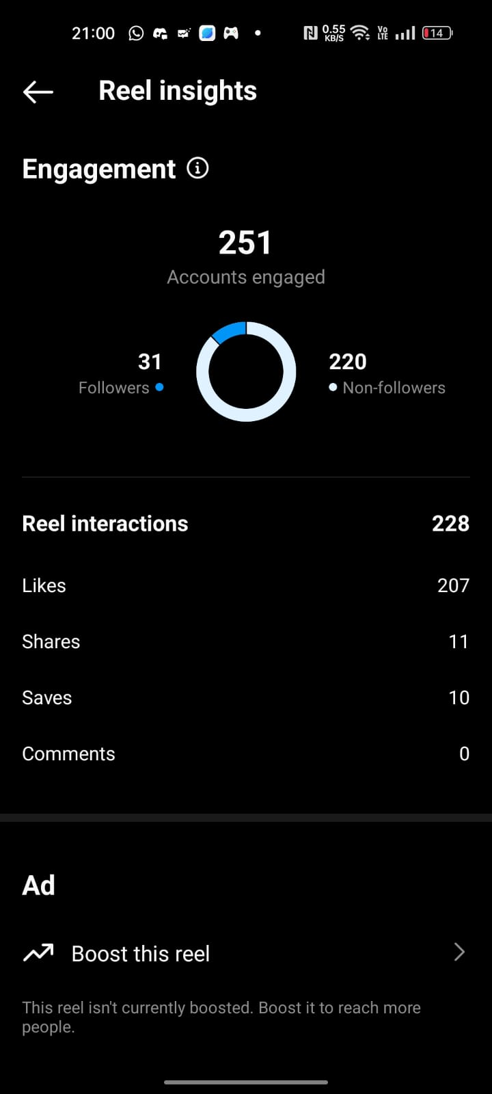
IG REELS

Slide 8
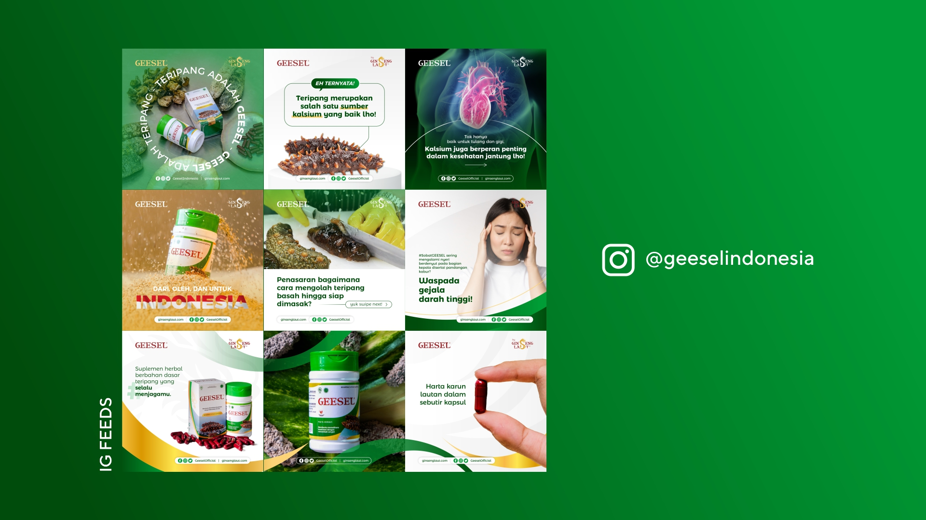

Slide 9
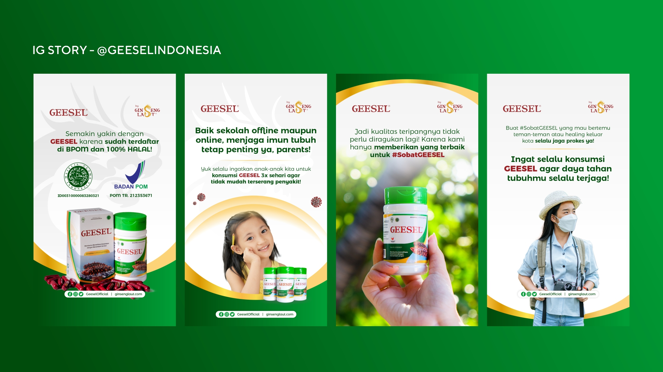

Slide 10
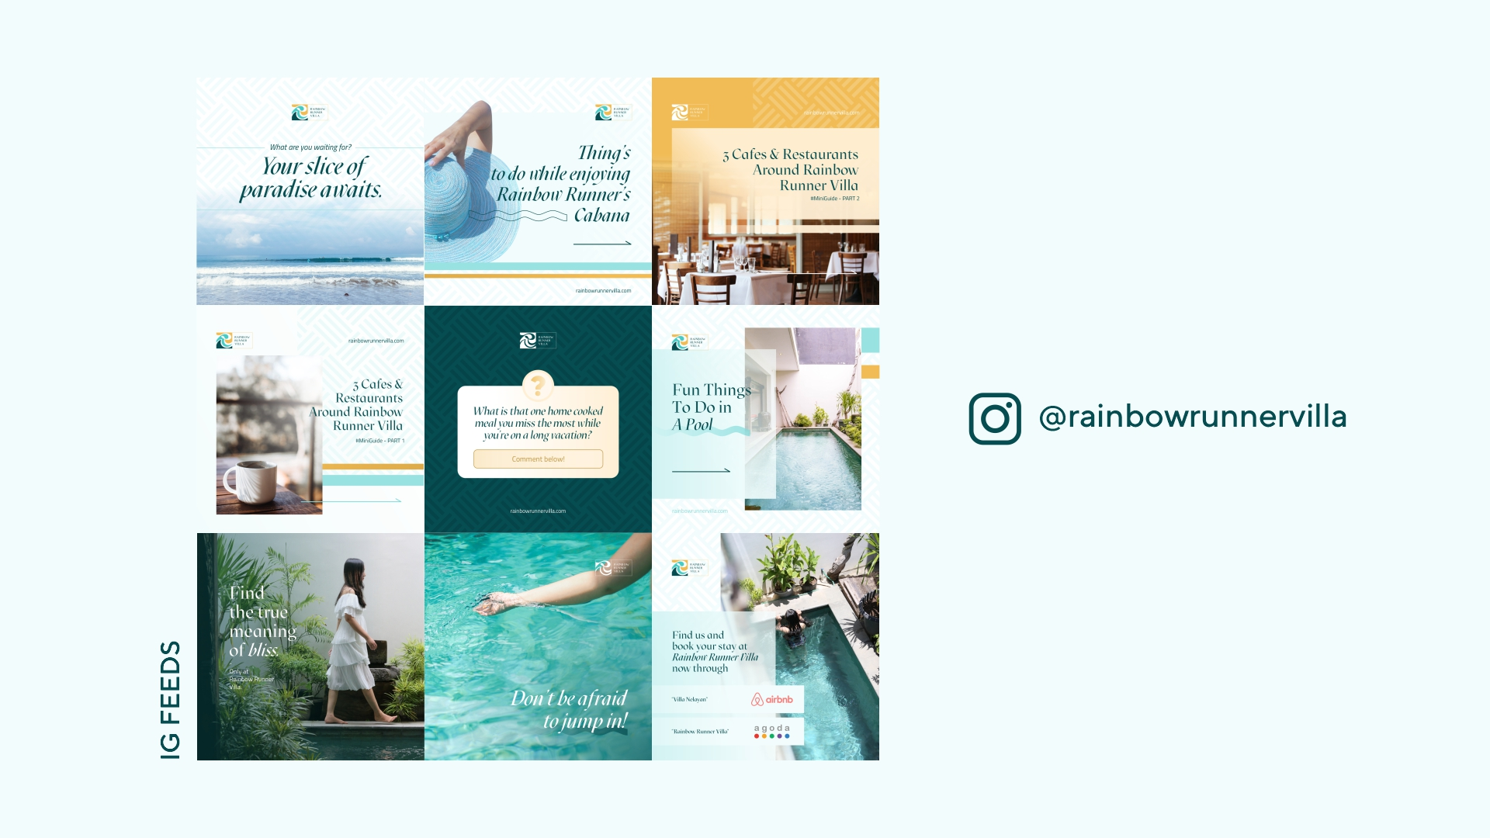

Slide 11
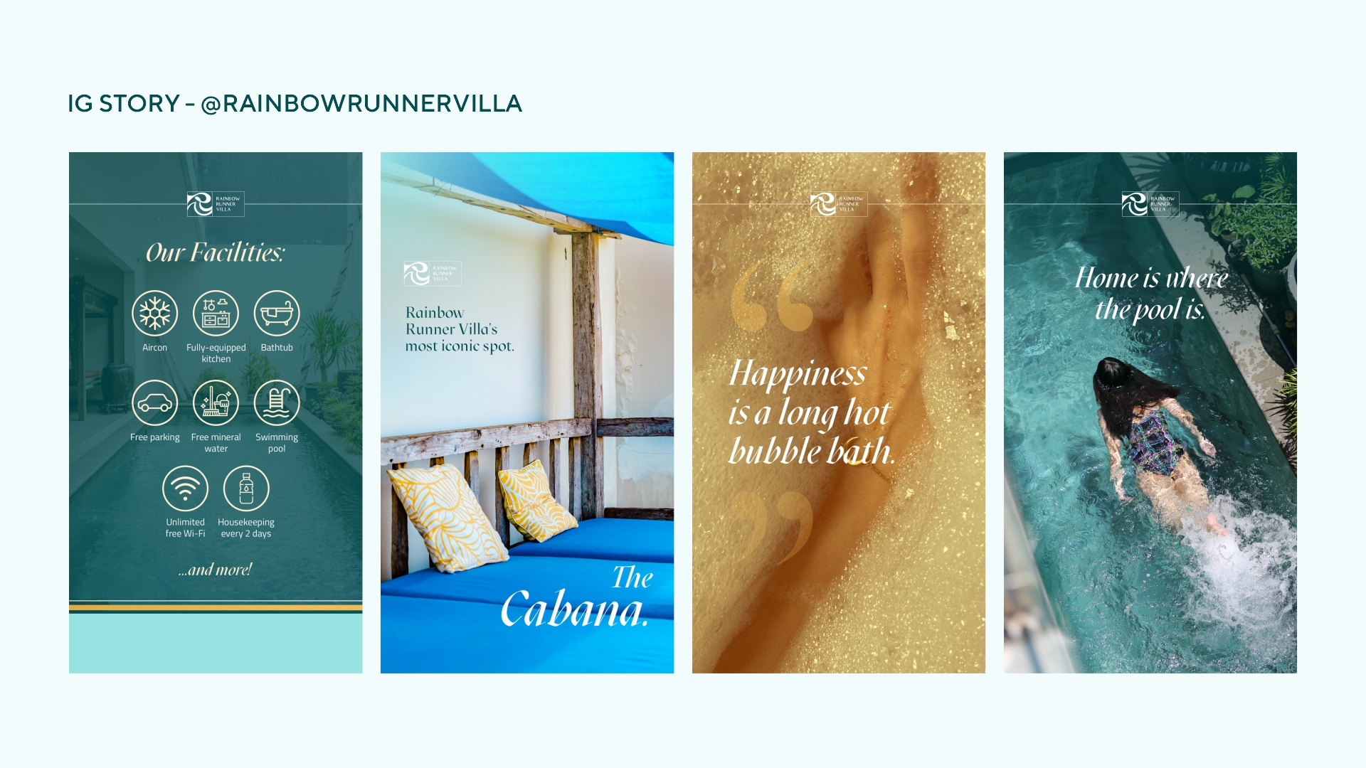

Slide 12
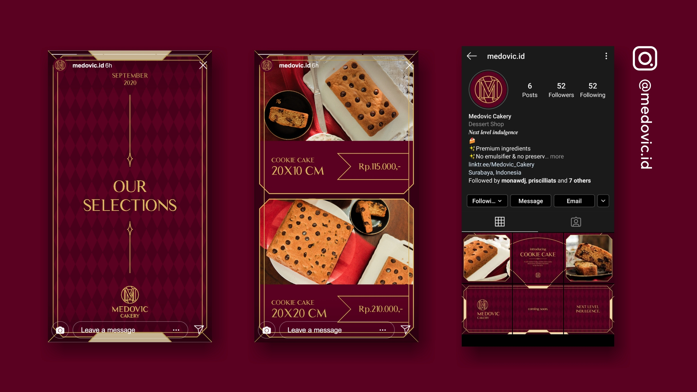

Slide 13
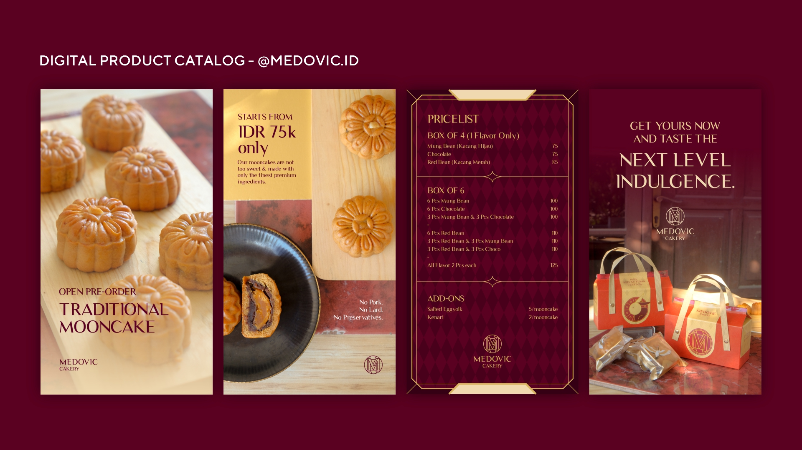

Slide 14
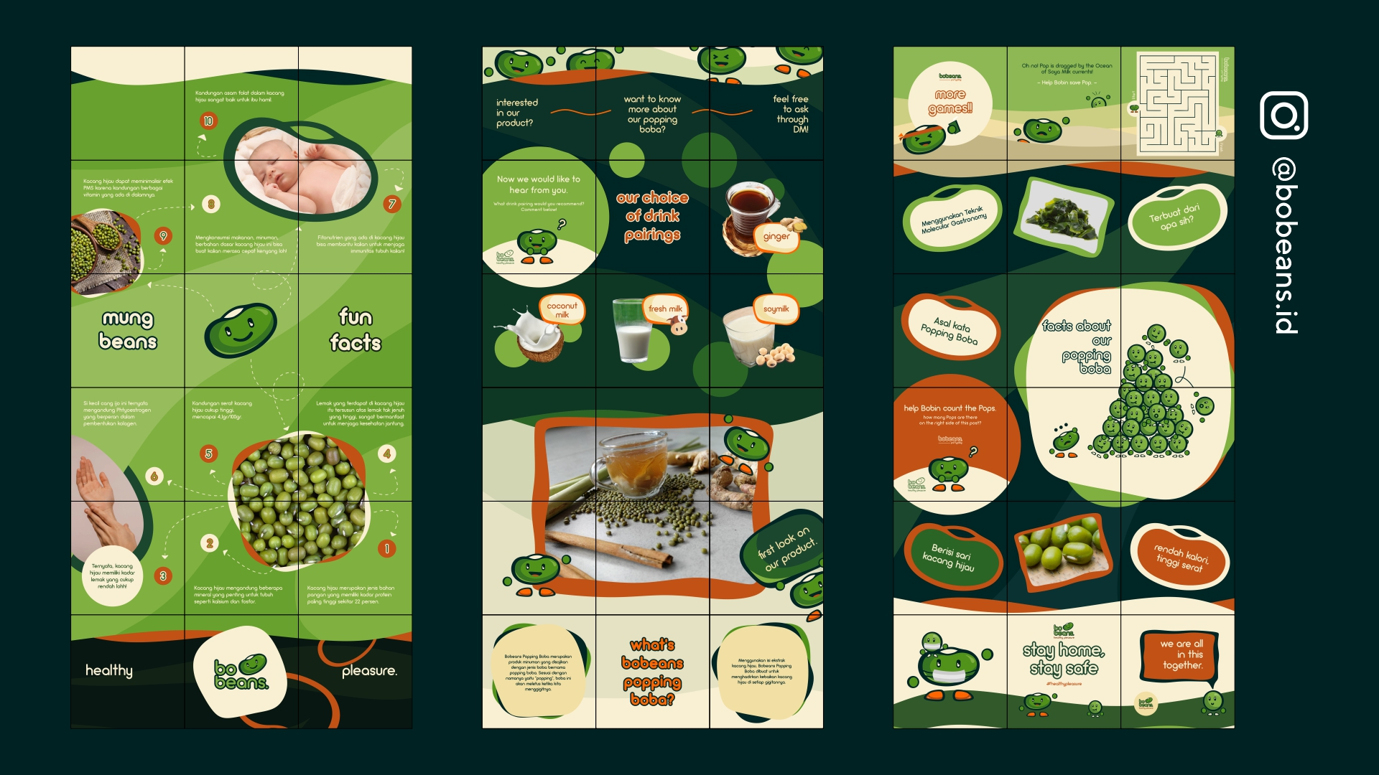

Slide 15
PRICELIST

Slide 16
MINI PACKAGE – Rp. 650.000,- /month*
9 personalized content design (no template)
Copywriting (content) + caption
Curated hashtag
Monthly online meeting
Admin for content-posting
*minimum contract period of 3 months.
Payment per month is acceptable with deposit (non-refundable for shortage contract issue). Deposit = 1 month worth of package fee

Slide 17
ESSENTIAL PACKAGE – Rp. 1.000.000,- /month*
15 personalized content design (no template)
Copywriting (content) + caption
Curated hashtag
Monthly online meeting
Admin for content-posting
*minimum contract period of 3 months.
Payment per month is acceptable with deposit (non-refundable for shortage contract issue). Deposit = 1 month worth of package fee

Slide 18
BASIC PACKAGE – Rp. 1.425.000,- /month*
20 personalized content design (no template)
1 IG REELS included
Copywriting (content) + caption
Curated hashtag
Monthly online meeting
Admin for content-posting
FREE** Announcement Story Template
*minimum contract period of 3 months.
Payment per month is acceptable with deposit (non-refundable for shortage contract issue). Deposit = 1 month worth of package fee.
**Free items are valid for one time per contract.

Slide 19
COMPLETE PACKAGE – Rp. 2.200.000,- /month*
28 personalized content design (no template)
2 IG REELS included
Copywriting (content) + caption
Curated hashtag
Online/Offline meeting every 2 weeks
Optional Facebook Page Repost (Setup included)
Admin for content-posting
FREE** Announcement Story Template (one-time)
FREE** 5 Highlight Covers (one-time)
*minimum contract period of 3 months.
Payment per month is acceptable with deposit (non-refundable for shortage contract issue). Deposit = 1 month worth of package fee.
**Free items are valid for one time per contract.

Slide 20
ADVANCED PACKAGE – Rp. 3.150.000,- /month*
42 personalized content design (no template)
3 IG REELS included
1 Monthly Product Photoshoot Session
Copywriting (content) + caption
Curated hashtag
Online/Offline meeting every 2 weeks
Optional Facebook Page Repost (Setup included)
Admin for content-posting
FREE** Announcement Story Template (one-time)
FREE** 5 Highlight Covers (one-time)
FREE** 2 Brochure Design (one-time)
*minimum contract period of 3 months.
Payment per month is acceptable with deposit (non-refundable for shortage contract issue). Deposit = 1 month worth of package fee.
**Free items are valid for one time per contract.

Slide 21
LIMITED OFFER

Slide 22
GET FREE PRODUCT PHOTOSHOOT SESSION
GET IDR500.000 DEDUCTION
By purchasing 6 months worth of Mini, Essential, or Basic package paid upfront.
By purchasing 6 months worth of Complete or Advanced Package paid upfront.

Slide 23
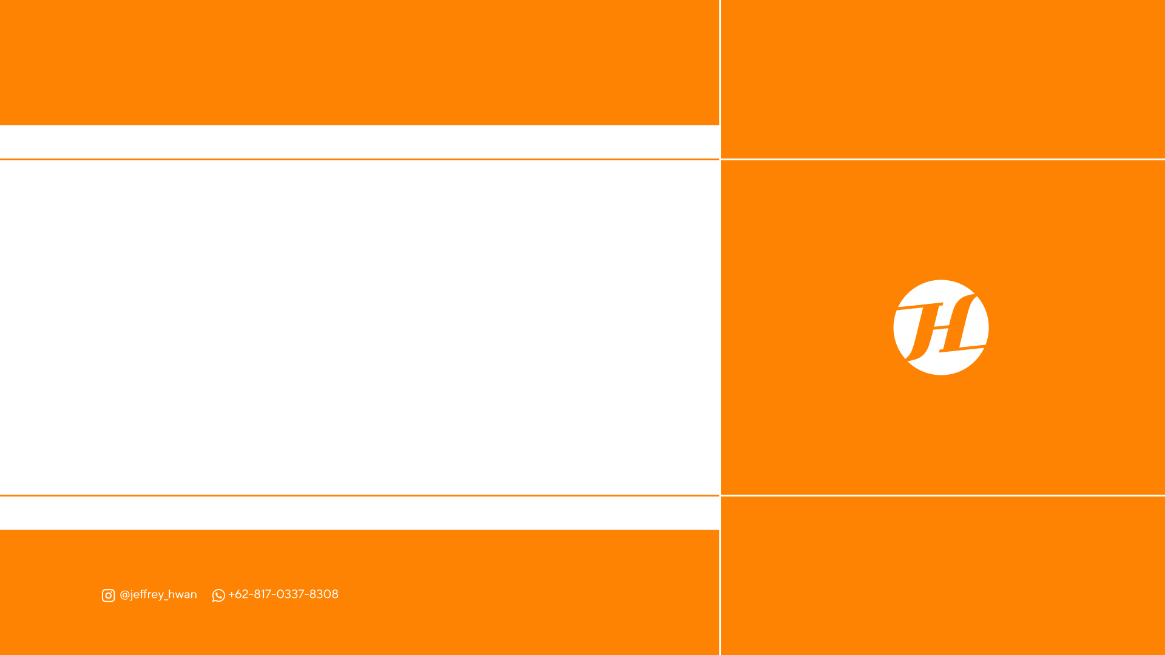
THANK YOU

